Slide 1
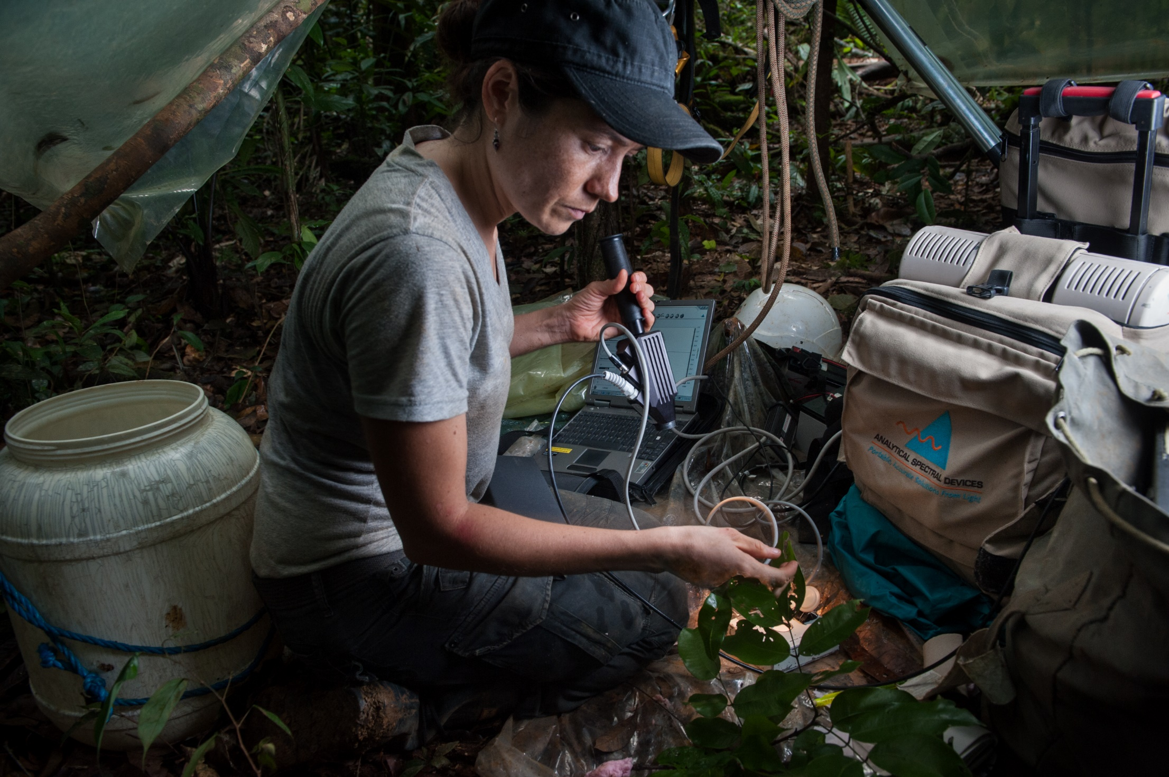
This research was made possible with a loan from
the NERC Field Spectroscopy Facility
FSF provide cutting edge equipment and training, FREE at the point of use, to all UK-based researchers and scientists
Equipment includes:
Field Spectroradiometers
Portable and Static Sun Photometers
UAV mounted hyperspectral and Multispectral Imagers
FTIR spectrometers
Underwater bio-optical equipment
Bruker EM27 Sun GHG monitoring spectrometer network
MAX DOAS Network
Spectral accessories
Contact FSF @NERC_FSF / fsf@nerc.ac.uk for more information

